Slide 1

Memory Wallet
A Digital Time Capsule

Slide 2
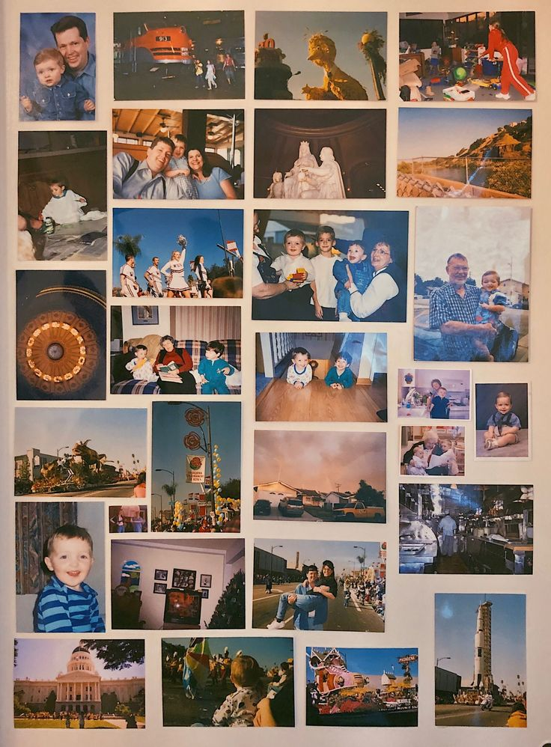
Content :-
Introduction
Features
How Memory wallet is best?
Technology
Live demo
Conclusion

Slide 3
Introduction
01

Slide 4
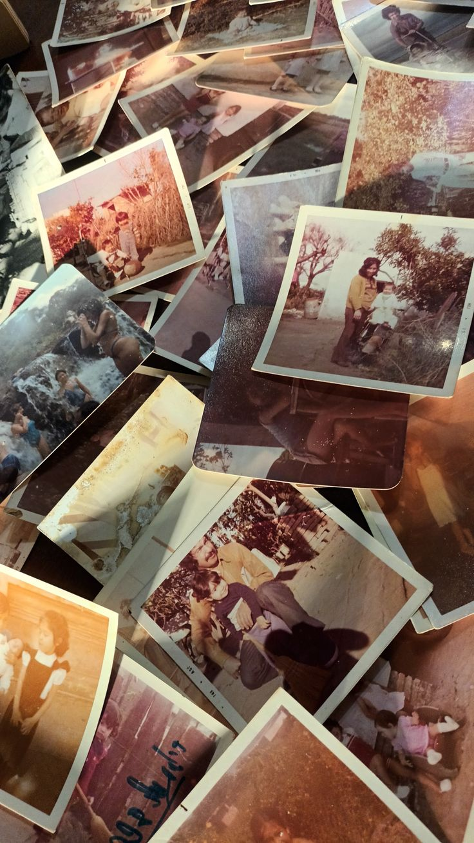
We all have a lot of memories in our mobile phones and in albums in the form of photos and videos. A single photo contains a lot of memories. When we look back to our memories we feel nostalgia. We all have lot of photos with many stories, and all photos contains a story within it, like, first step of a baby, beautiful moments with the friends, crazy moment of our college fairwell and a photo of our first success. These photos are special for us. So, we should kept these photos and stories secure.

Slide 5
Features
02

Slide 6
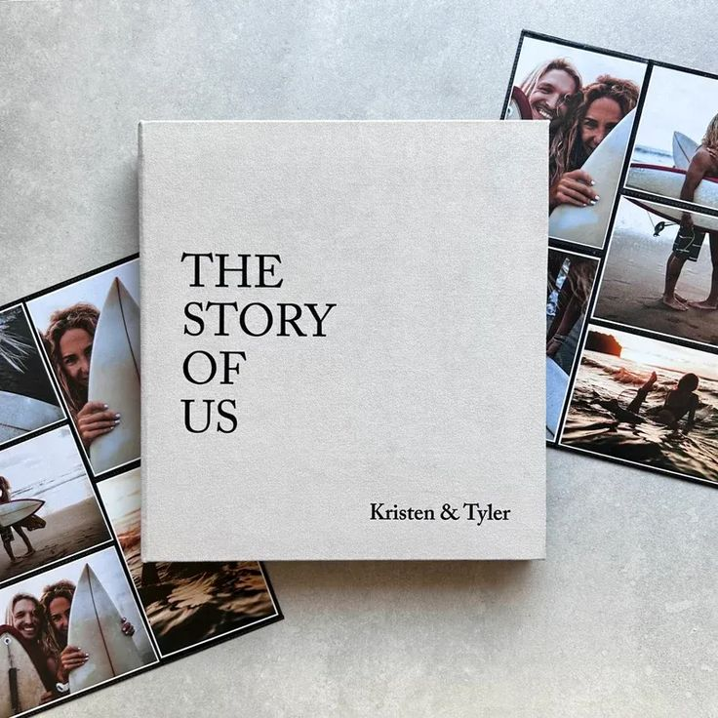
There are 3 main features of memory wallet -
1.Captionizing Photos
2. Login
3. Time Capsule
Memory wallet gives access user to captionize the pictures .
We can captionize the images in the form of text, audio, and also speech-to -ext form.
Memory wallet also gives a " login " feature. By this feature, only user have access to open their wallet.
We can put the date on a specific photo, then this photo will automatically pop out on that particular day only. Like birthday photos, anniversary photos.

Slide 7
How Memory Wallet is Best?
03

Slide 8

3. Personalized Narration
Photos/videos come with audio narration in local language. Like, A photo of a wedding → app plays grandma’s voice telling the story.
This makes memories accessible without reading.
1. Target Audience: Elders (esp. illiterate ones)
Designed specifically for elders in Bihar/India who can’t read or use tech easily.
Interface could be voice-based (in Hindi/Bhojpuri) instead of text-based.
Family members can upload voice notes or video stories, not just pictures.
5. Digital Legacy:
Works as a digital diary for families → stories can be passed down generations.
Future children can “hear their great-grandparents’ voices” → something Google Photos doesn’t do.
2. Time Capsule Concept
Instead of just storing, it allows unlocking memories at special times:
Birthdays, anniversaries, or after a set number of years.
Emotional surprise factor → like “your family speaking to future you.”
4. Cultural & Emotional Touch:
Focus on family, traditions, festivals, regional language → unlike Google Photos which is generic.
Elders feel connected not only to pictures, but to heritage.

Slide 9
Tecnology
04

Slide 10
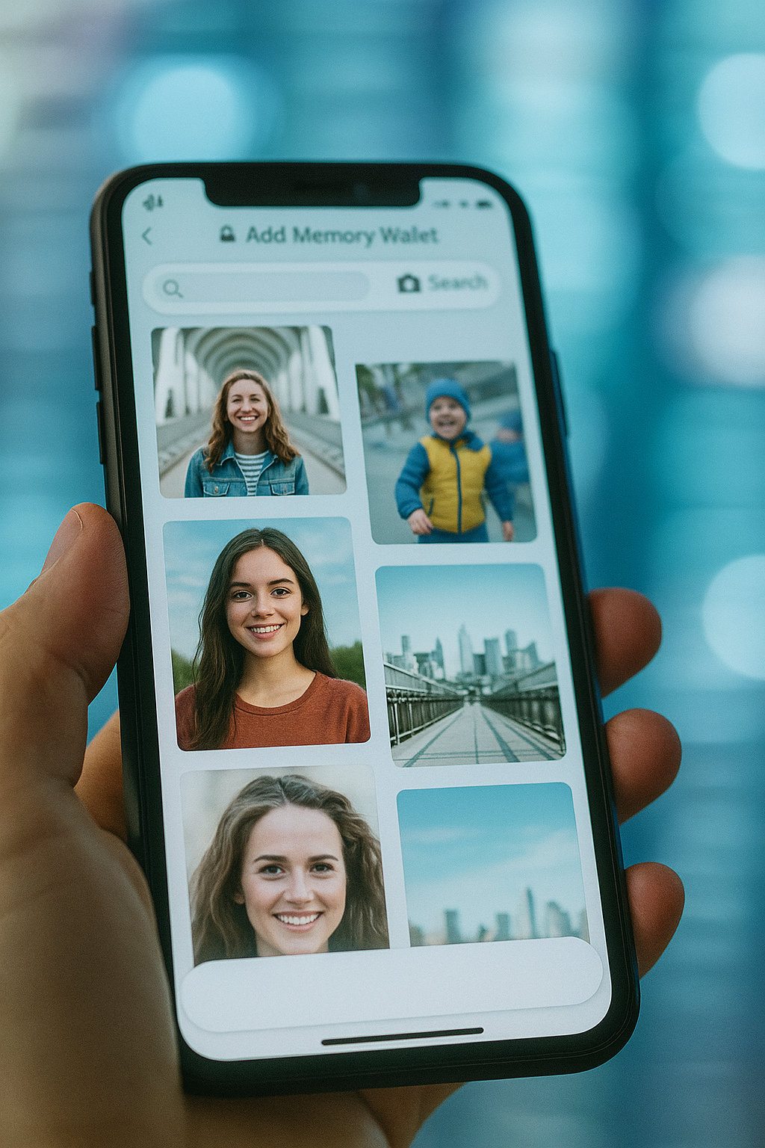
Backend
Openai
Fastapi
SQL
Jose
Frontend
Streamlit

Slide 11
Live Demo
05

Slide 12
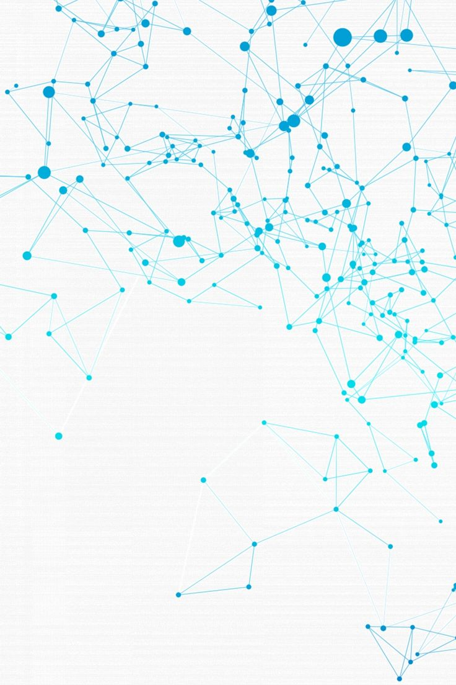

zz
Github Link:

Slide 13
Conclusion
06

Slide 14
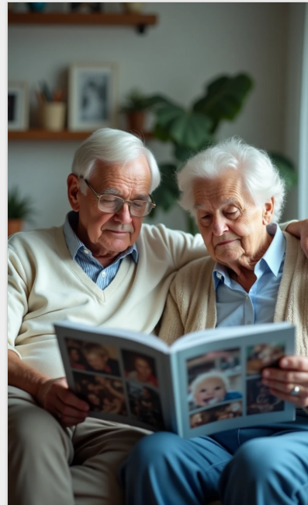
Memory Wallet preserves life stories in a human, voice-driven, culturally personal way—making it usable and emotional for illiterate elders.
By the Memory Wallet, we can create and write own story.

Slide 15
Thank you
Our Team:-
Shreeya Sanchi (shreyasanchi95@gmail.com)
Priyanka Gupta (guptapriyankagupta76@gmail.com)
Vanshika Gupta (vanshu182005@gmail.com)

